Slide 1
Errors and Seven Flavors of Context
Samia Arshad
Computer Science Department

Slide 2
Errors
Humans make frequent errors
Design for error prevention
2 Types of errors:
Slips
Mistake

Slide 3
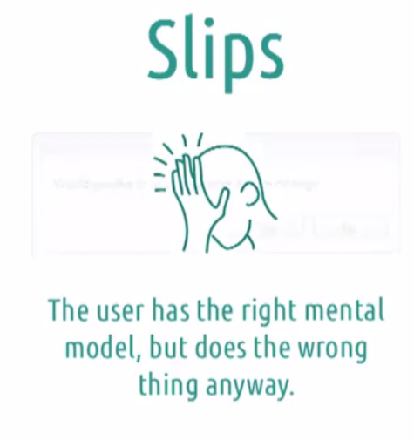
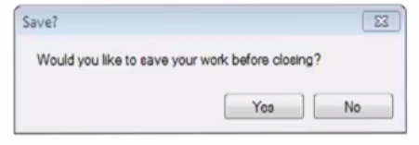
User Error - Slips

Slide 4
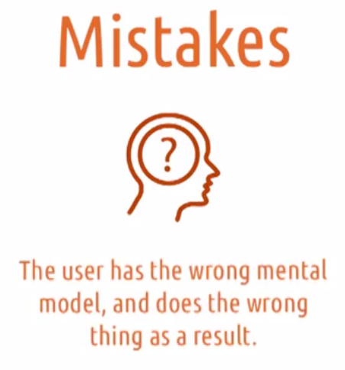
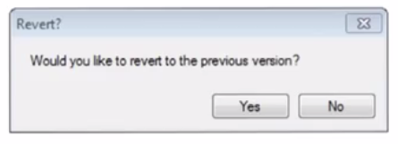
User Error – Mistake

Slide 5
Slips Mistakes
Usually subconscious Usually Conscious
Often by experts Often By beginners
Avoided by feedback Corrected by new knowledge

Slide 6
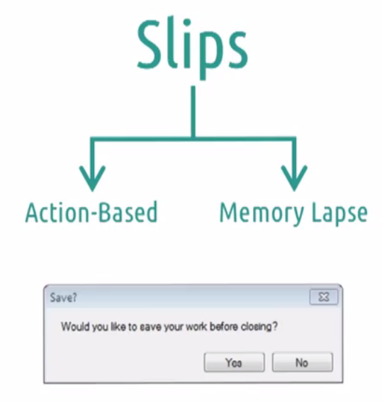
Type of Slips
Doing the wrong things
Forgetting to do the right things

Slide 7
Types of slips
Capture slips
A capture error is a frequently done activity that takes over (captures) the intended action.
a person may inadvertently perform one action while intending to do another.
e.g. counting nos after playing cards
Description Similarity slips
A description error is when the correct action is carried out on the wrong object.
Description similarity slips occur when an action is taken upon an item that is similar to the one you intended.
e.g.milk pack while preparing coffee
Memory lapse slips:
when your memory fails
e.g. leaving for work lights on

Slide 8
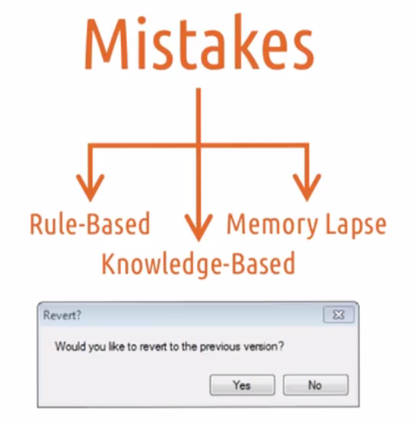
Type of Mistakes
Rule-Based: Correctly access the state of the world but makes the wrong decision based on it .
wrong knowledge,mismatch with the past.
e.g. toyota new model car engine
Knowledge-Based:
When user incorrectly access the state of the world at 1st place
.
no knowledge,novel situation
e.g. no idea of fixing engine.

Slide 9
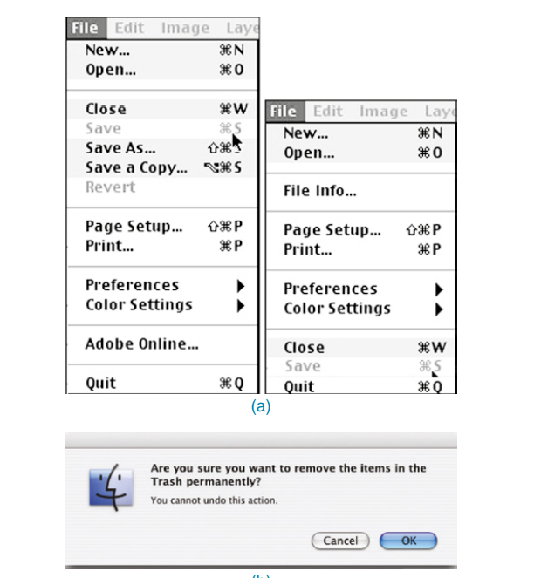
Error Prevention

Slide 10
Exercise
Using Excel to make data available for
SQL-queries.
You installed a SQL server but forgot to give it privileges to pass data through firewall

Slide 11
Design with Context
Context refers to the physical, digital, and social structures that surround the point of use of any system application.
Its valuable in drafting product strategy, choosing which devices to support, planning your communications, and more.

Slide 12
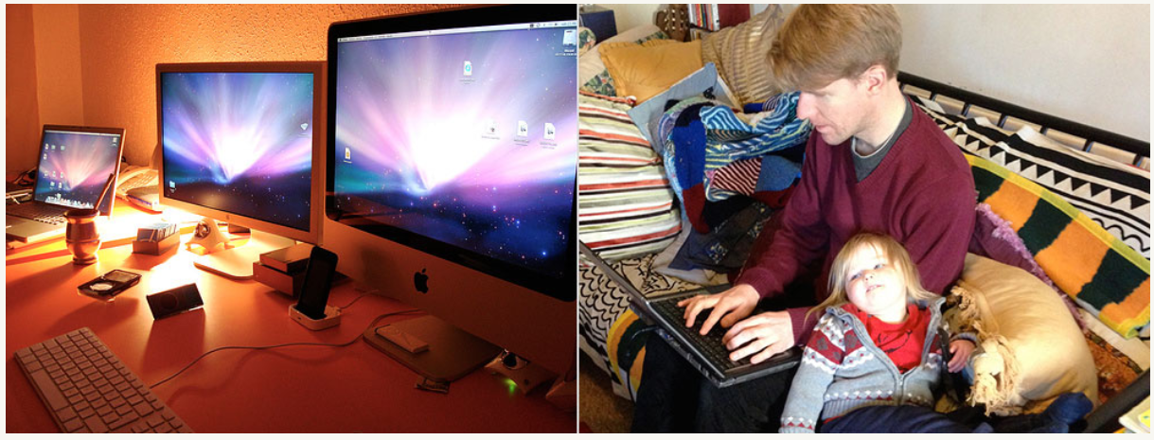
Desktop context
Desktop context: point of use is uniform and familiar. User is static and free to concentrate.

Slide 13

Mobile Context
Mobile context: point of use is not uniform or familiar.

Slide 14
Seven Flavors of the Context
Following seven flavors of context cover all the important facets about different types of contextual information you might spot, and what your findings may mean for your design.
DETAILS

Slide 15
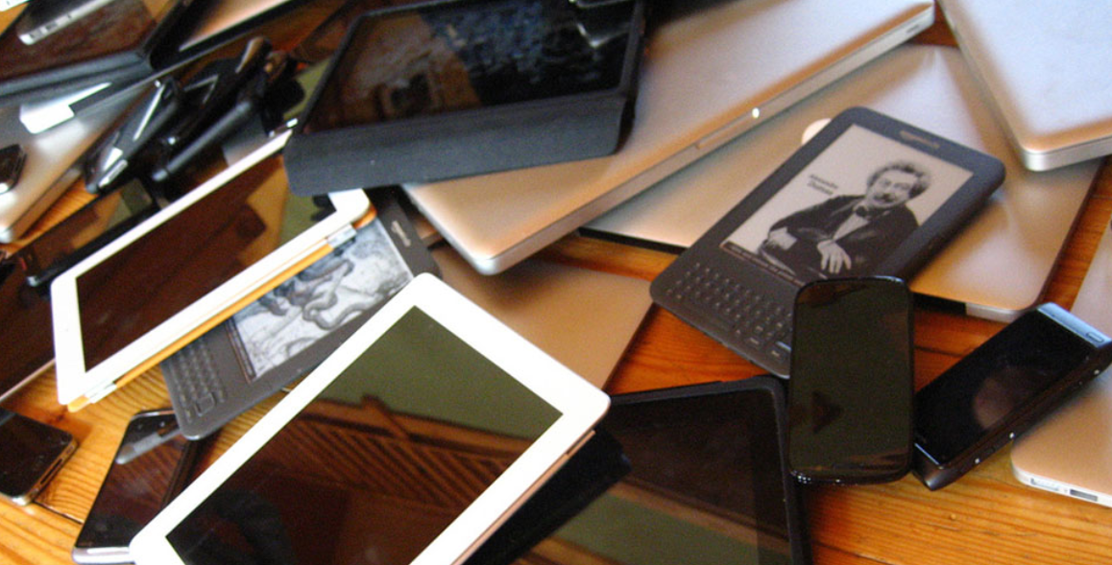
Device Context
Device context: A device’s form and capabilities will shape a user’s approach.
which device would be best suited for our app.

Slide 16
Device Context
Questions to ask
What devices will this product be used on?
How about in a year’s time? Three? Five?
What can those devices do? What can’t they do?
What sort of interactions do these devices suit?
Are there unique device capabilities we can use to our advantage?
How does our site work on devices that don’t have those capabilities?
Are there device capabilities that might make life more difficult? How can we mitigate their impacts?

Slide 17
Environmental Context
Environmental context: The physical environment around an interaction
Questions to ask
Will the site be used indoors or outdoors?
Should weather conditions affect my design?
What environmental information sources are relevant to the interaction?
Will a user understand why, and how, my system is adapting to the environment?
How can I make my product feel natural within its environment?

Slide 18
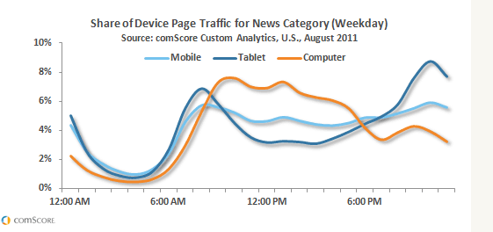
Time Context
Time context: Time of use is often linked to the user’s environment, location, and activity.

Slide 19
Time Context
Questions to ask
Are there particular times of day that our app is best suited for?
What else is happening then?
How long will the user be interacting with our site for?
How often?
How can our design fit those patterns of use?

Slide 20
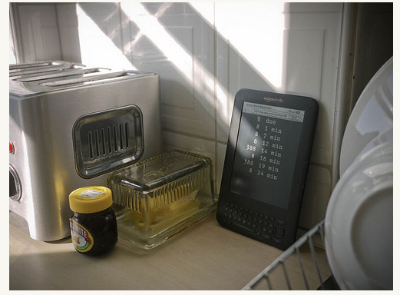
Activity Context
Activity context: What do users want to do, anyway?

Slide 21
Activity Context
Questions to ask
Do users have simple tasks to fulfil, or a more complex network of activities?
Are these activities or tasks digital, or do they support real-world activities?
Does the current activity have a physical component? How can we support that?
Are the interactions likely to be lean-forward, lean-back, or both?

Slide 22
Location Context
Location context: Location of usage
Questions to ask
Do users have location-specific needs?
Will access to the user’s location improve the service my app can offer?
How can I best communicate why a user should grant location access?
Can I present location information in a more human-friendly format than long/lat?
How can I be sure my location assumptions are accurate?

Slide 23
Individual Context
Individual context: The abilities and limitations of the human body
Questions to ask
Can we use any stated preferences to tailor the system to an individual user?
Is it appropriate to let users explicitly state preferences for this interaction?
What sort of emotional connection will users have with our site, and the devices they access it from?
What mental attitudes do users bring to the interaction?

Slide 24
Social Context
Social context: who else is nearby to the user.
Questions to ask
Will the app be used in solo, private contexts, or in public?
Are there ways to reduce any risk of embarrassment or public discomfort for the user?
Who else is involved in this activity other than the end user?
Is there benefit in asking the user to authorise my app with their social networks?
Does my app protect the user’s sensitive information with sufficient care?

Slide 25
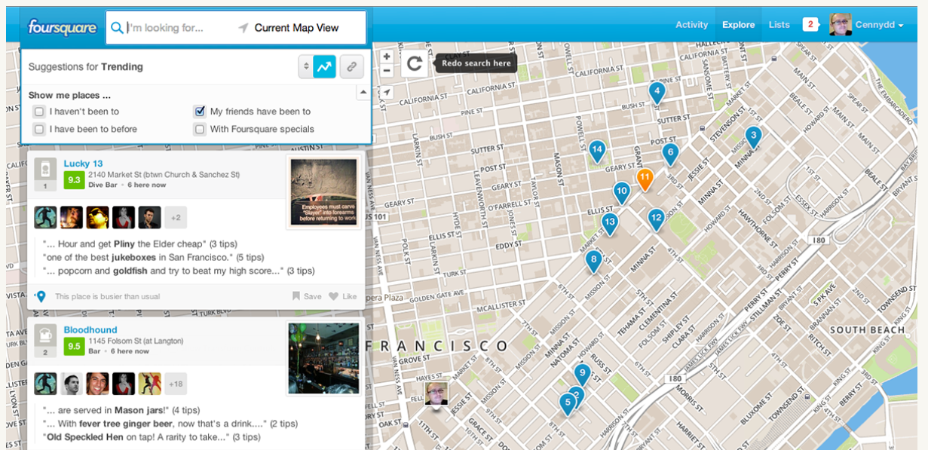
Context Design Principles
Context is multi-faceted
Don’t penalize people for their context
Assume gently
Allow adoptability
Revisit your decisions

Slide 26
Conclusion
Conceptual Model
Overall picture
Why conceptual model
Seven flavors of Contextual design
Context design principles
https://uxmag.com/articles/the-secret-to-designing-an-intuitive-user-experience
https://www.cennydd.com/writing/designing-with-context

